Slide 1
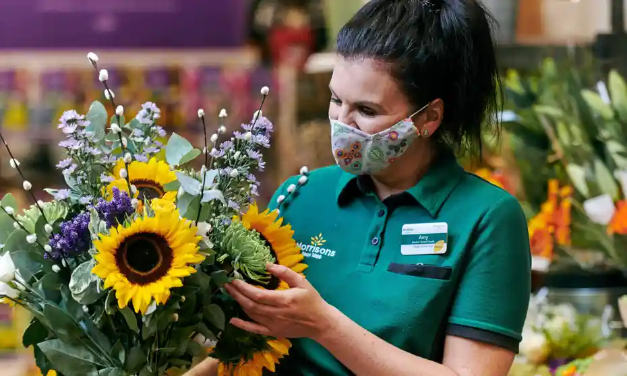

Thanksgiving & Christmas 2022
Floral Results
March 2023

Slide 2
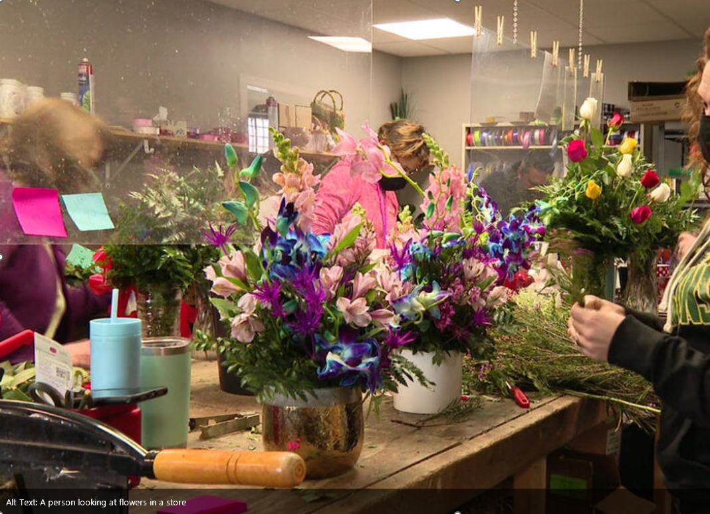
Supermarket Floral Department
Thanksgiving 2022 (4 w/e 11/27/22))
Dollar sales lower than 2021
Unit sales lower than 2021
Price increases over 2021 in most categories
Notes:
Unsure about the future, bracing for extremes, yet ready to move forward. Consumers survived a pandemic and economic downturn and are ready for a vibrant future.
Today, we are going to talk about the industry and consumers trends that are the foundation for 2023’s business environment.

Slide 3
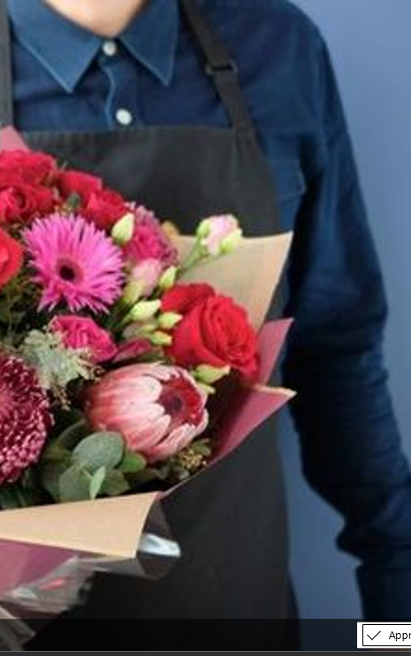

Thanksgiving
Floral continued to lose ground Thanksgiving 2022
Dollar Sales | $433.2M | -$10.8M | -2.4%
Unit Sales | 42.2M | -2.3M | -5.2%
Thanksgiving 2022 suffered from an overall decline in base floral sales with less distribution, shelf space, and velocity
Notes:
Most economists expect the global economy to sputter in 2023 before rebounding in 2024.
Over the past half century, inflation above 5% has never been tamed without incurring a recession. Economist expect the U.S. economy will steadily soften through the first half of 2023, ushering in a brief, modest recession at end of the second quarter.
Food prices are expected to grow more slowly in 2023 than in 2022 but are still above historical average rates.
In 2023, all food prices are predicted to increase 7.1 percent.
Food-at-home prices are predicted to increase 8.0 percent
Food-away-from-home prices are predicted to increase 8.2 percent
BLS

Slide 4
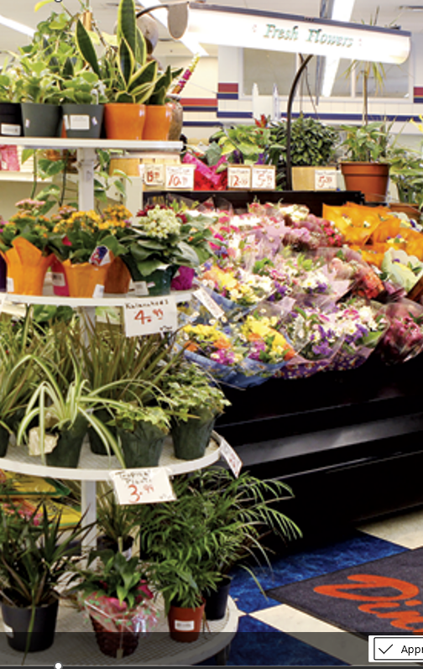
Thanksgiving
94.6% of Thanksgiving sales came from base sales which declined by -2.6%
$ Trade Efficiency
30.2 | -5.1pts
Manage base sales by offering your most popular products front and center
Weeks of Support
3.2 | +0.1wks
% Dollars, Any Merch
Incremental Sales
18.0 | +3.1pts
$23.5M | +0.7% | +$0.2M
Promo Price/Unit
$8.53 | -0.5%
Dollar Sales
$433.2M | -2.4% | -$10.8M
TPOD
8,915 | -619pts
Base Sales
Weekly Items/Store
$409.6M | -2.6% | -$11.0M
52.9 | -2.7pts
Base Price/Unit
$11.01 | +4.3%
Avg. Wkly Base $/$MM ACV
$71.3 | -10.6%
Notes:
Most economists expect the global economy to sputter in 2023 before rebounding in 2024.
Over the past half century, inflation above 5% has never been tamed without incurring a recession. Economist expect the U.S. economy will steadily soften through the first half of 2023, ushering in a brief, modest recession at end of the second quarter.
Food prices are expected to grow more slowly in 2023 than in 2022 but are still above historical average rates.
In 2023, all food prices are predicted to increase 7.1 percent.
Food-at-home prices are predicted to increase 8.0 percent
Food-away-from-home prices are predicted to increase 8.2 percent
BLS

Slide 5
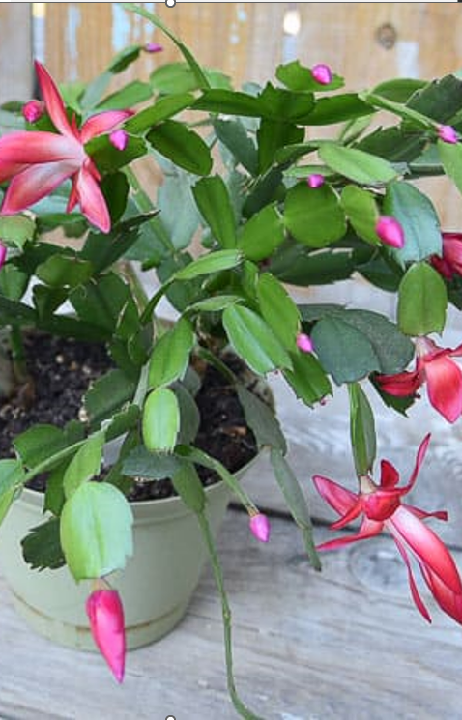
Thanksgiving
Potted plants while still 3rd in dollar sales suffered large dollar & volume declines compared to 2021
 | Dollar Sales (MM) | % Chg vs YA | Unit Sales (MM) | % Chg vs YA | Avg. wkly $MM ACV | Chg vs YA | Price/ Unit | % Chg vs YA | % Dollar, Any Merch | Chg vs YA
Bouquet | $92.7 | +2.1% | 7.1 | -2.0% | $19.0 | -$1.0 | $13.01 | +4.2% | 13.2 | +3.1
Rose | $81.6 | +4.3% | 7.0 | +3.4% | $15.8 | -$0.8 | $11.71 | +0.9% | 20.4 | +8.0
Potted Plant | $79.6 | -12.6% | 8.4 | -16.6% | $15.7 | -$3.0 | $9.43 | +4.9% | 18.5 | +2.7
Arrangement | $65.8 | -0.4% | 2.2 | -6.9% | $14.0 | -$1.4 | $29.28 | +6.9% | 23.7 | -0.4
Consumer Bunch | $63.2 | +1.4% | 10.1 | -4.8% | $13.3 | -$0.9 | $6.25 | +6.5% | 12.1 | +0.6
Holiday | $14.9 | -14.6% | 0.8 | -11.0% | $7.1 | -$1.5 | $18.81 | -4.1% | 14.4 | +4.1
Outdoor Plant | $10.0 | -5.6% | 1.5 | -10.5% | $3.7 | -$2.8 | $6.80 | +5.5% | 13.8 | -3.3
Bulb | $3.7 | -16.3% | 0.9 | +0.7% | $1.6 | -$0.7 | $4.23 | -16.9% | 40.9 | +19.3
Seed | $1.6 | -39.5% | 1.3 | +32.5% | $1.4 | -$0.2 | $1.24 | -54.4% | 12.8 | -3.8
Lean in on wellness trends to maintain and grow sales in potted plants.

Slide 6
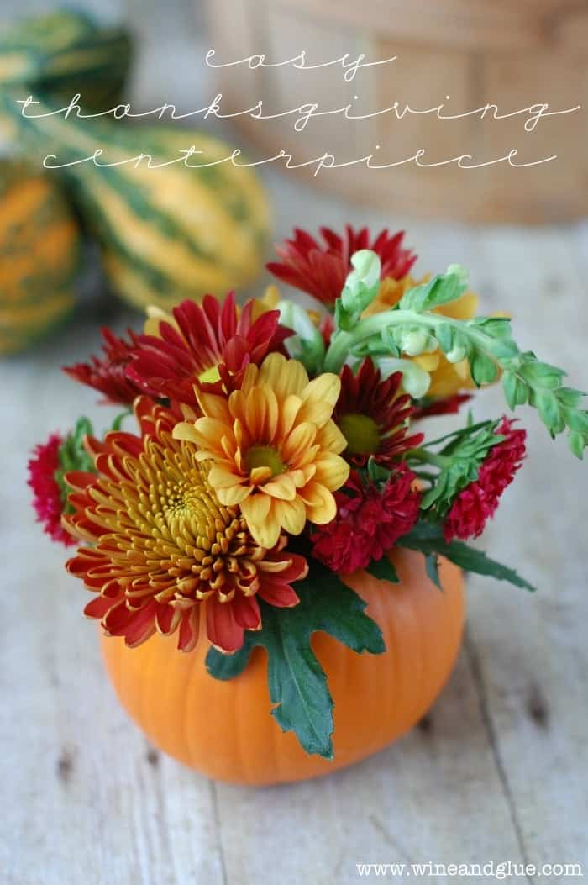
Thanksgiving
Arrangements declined in dollar sales as consumers pulled back in spending
 | Chg vs YA ($MM) | Dol Sales ($MM) | % Chg vs YA | TPOD | Chg vs YA | Wt. Base Price/ Unit | % Chg vs YA | Promo Price | Chg vs YA
Arrangement | -$0.3 | $65.8 | -0.4% | 606.4 | -72.5 | $31.54 | +7.3% | $30.55 | +1.81
Outdoor Plant | -$0.6 | $10.0 | -5.6% | 704.0 | -39.8 | $7.48 | +2.6% | $5.56 | +1.15
Bulb | -$0.7 | $3.7 | -16.3% | 617.3 | +85.1 | $5.67 | -7.3% | $4.00 | +0.27
Seed | -$1.0 | $1.6 | -39.5% | 226.7 | -93.1 | $1.58 | -50.8% | $0.20 | -0.94
Holiday | -$2.5 | $14.9 | -14.6% | 228.1 | -16.6 | $19.09 | -3.4% | $11.46 | -0.41
Potted Plant | -$11.5 | $79.6 | -12.6% | 2,676.5 | -602.5 | $10.14 | +5.1% | $8.13 | +0.73
Offering arrangements at various price points allows consumers to find room in their budget for this Thanksgiving favorite
1
2
3
4
5
6

Slide 7
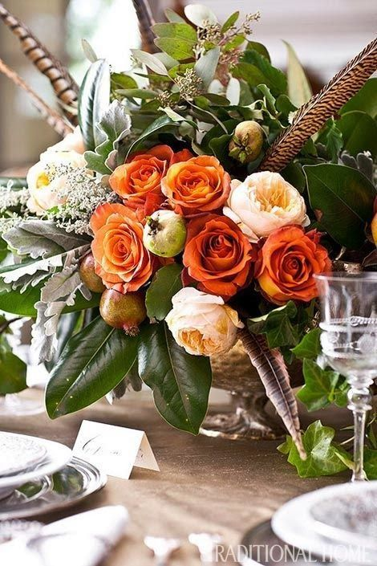
Thanksgiving
Rose was the only category to increase in dollar and volume sales
 | Chg vs YA ($MM) | Dol Sales ($MM) | % Chg vs YA | TPOD | Chg vs YA | Wt. Base Price/ Unit | % Chg vs YA | Promo Price | Chg vs YA
Rose | +$3.3 | $81.6 | +4.3% | 1,005.7 | +6.1 | $12.88 | +5.5% | $9.00 | -0.15
Bouquet | +$1.9 | $92.7 | +2.1% | 1,243.7 | +2.7 | $13.52 | +5.4% | $11.29 | +1.00
Consumer Bunch | +$0.9 | $63.2 | +1.4% | 1,423.4 | +121.6 | $6.47 | +7.1% | $5.56 | +0.60
As roses continue in popularity, highlight this product in unique bouquets and arrangements to advance those sales.
1
2
3

Slide 8
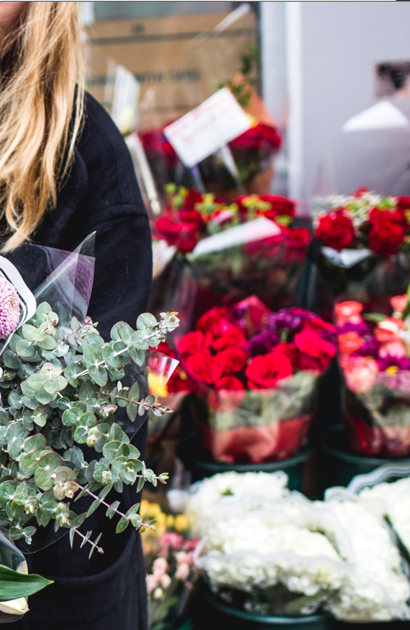
Thanksgiving
Dollar sales declined from 2021 but held over 2020
Review product assortment to keep continue growing dollar sales.

Slide 9
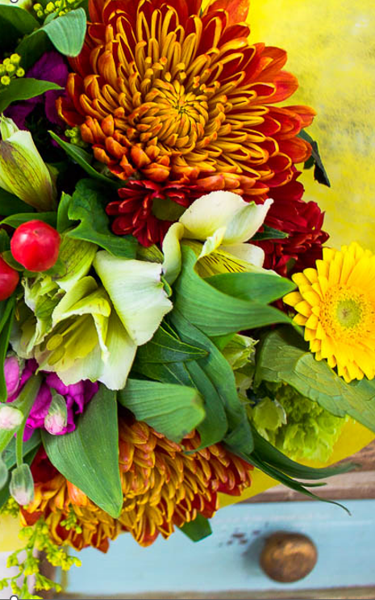
Thanksgiving
Unit sales dropped to 2020 levels
Review product assortment and discounts to grow unit sales.

Slide 10
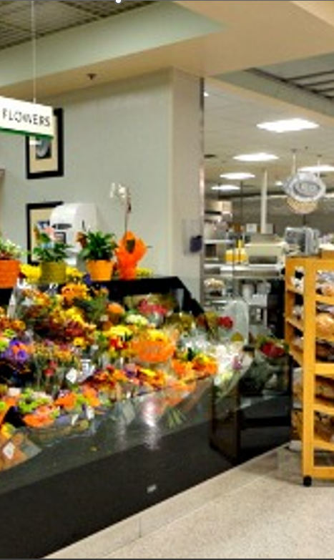
Thanksgiving
Floral kept its price increase over the holiday
Continue to promote the value of floral to maintain and increase price.

Slide 11
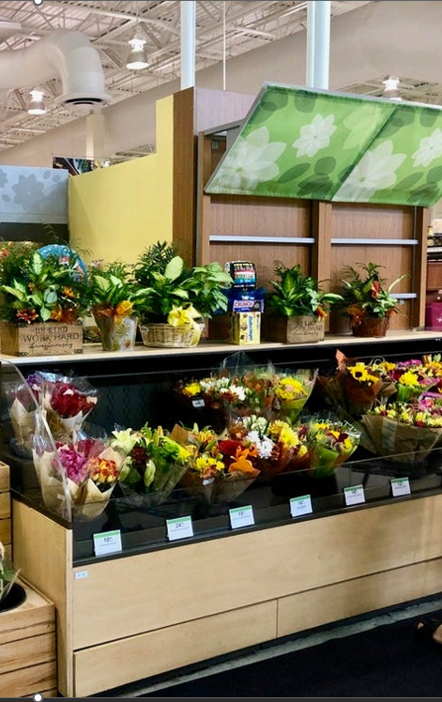
Thanksgiving
Floral average dollar & unit sales were lower in 2022 than 2021
Review product assortment, pricing strategies, and promotional messaging to increase dollar and unit sales for Thanksgiving

Slide 12
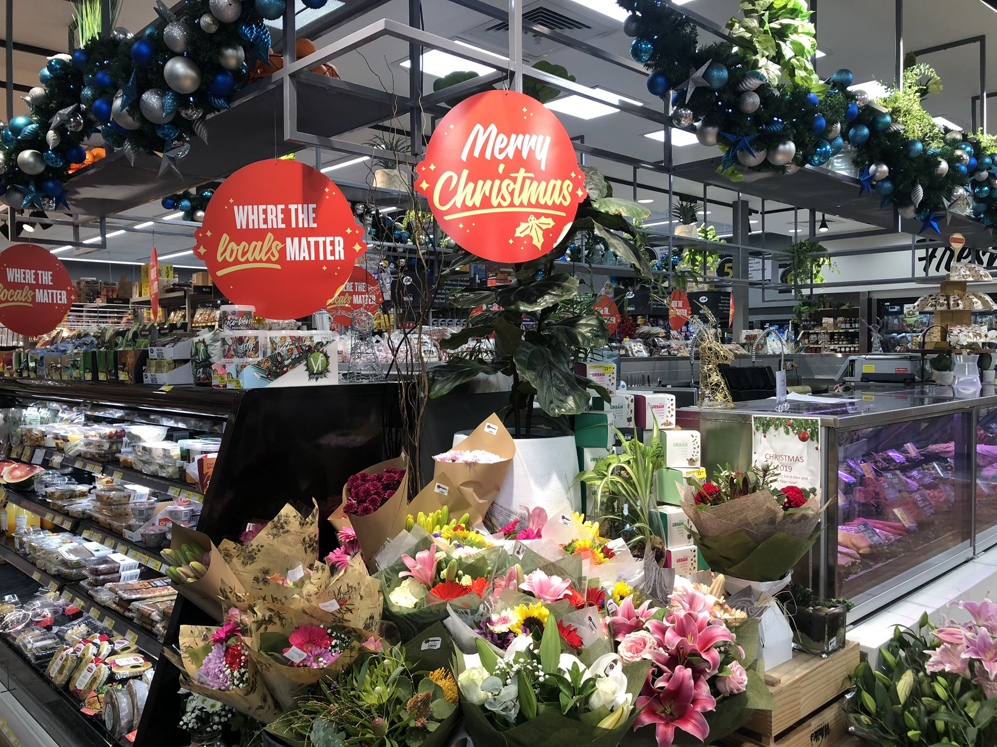
Supermarket Floral Department
Christmas 2022 (4 w/e 01/01/23)
Dollar sales lower than 2021
Unit sales lower than 2021
Price increases over 2021 in most categories
Notes:
Unsure about the future, bracing for extremes, yet ready to move forward. Consumers survived a pandemic and economic downturn and are ready for a vibrant future.
Today, we are going to talk about the industry and consumers trends that are the foundation for 2023’s business environment.

Slide 13
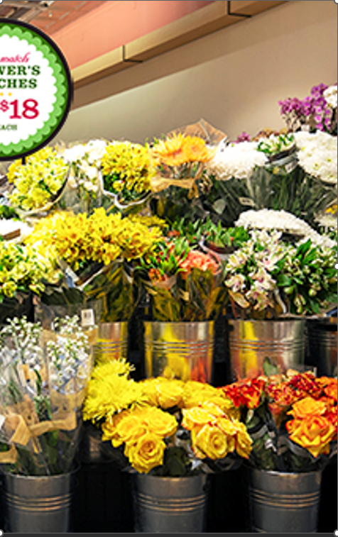

Christmas
Floral continued to lose ground Christmas 2022
Dollar Sales | $451.2M | -$4.9M | -1.1%
Unit Sales | 42.0M | -2.7M | -6.0%
Christmas 2022 suffered from an overall decline in base floral sales with less distribution, shelf space, and velocity
Notes:
Most economists expect the global economy to sputter in 2023 before rebounding in 2024.
Over the past half century, inflation above 5% has never been tamed without incurring a recession. Economist expect the U.S. economy will steadily soften through the first half of 2023, ushering in a brief, modest recession at end of the second quarter.
Food prices are expected to grow more slowly in 2023 than in 2022 but are still above historical average rates.
In 2023, all food prices are predicted to increase 7.1 percent.
Food-at-home prices are predicted to increase 8.0 percent
Food-away-from-home prices are predicted to increase 8.2 percent
BLS

Slide 14
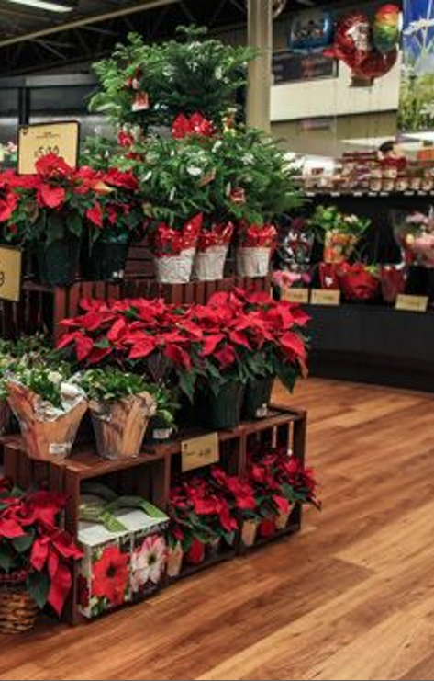
Christmas
94.3% of the Christmas sales came from base sales which declined by 1.6%
$ Trade Efficiency
28.0 | -0.7pts
Manage base sales by offering your most popular products front and center
Weeks of Support
3.4 | +0.0wks
% Dollars, Any Merch
Incremental Sales
20.5 | +2.4pts
$25.9M | +9.1% | +$2.2M
Promo Price/Unit
$9.65 | +4.4%
Dollar Sales
$451.2M | -1.1% | -$4.9M
TPOD
8,585 | -312pts
Base Sales
Weekly Items/Store
$425.4M | -1.6% | -$7.0M
53.4 | -0.5pts
Base Price/Unit
$11.72 | +6.2%
Avg. Wkly Base $/$MM ACV
$72.4 | -9.9%
Notes:
Most economists expect the global economy to sputter in 2023 before rebounding in 2024.
Over the past half century, inflation above 5% has never been tamed without incurring a recession. Economist expect the U.S. economy will steadily soften through the first half of 2023, ushering in a brief, modest recession at end of the second quarter.
Food prices are expected to grow more slowly in 2023 than in 2022 but are still above historical average rates.
In 2023, all food prices are predicted to increase 7.1 percent.
Food-at-home prices are predicted to increase 8.0 percent
Food-away-from-home prices are predicted to increase 8.2 percent
BLS

Slide 15
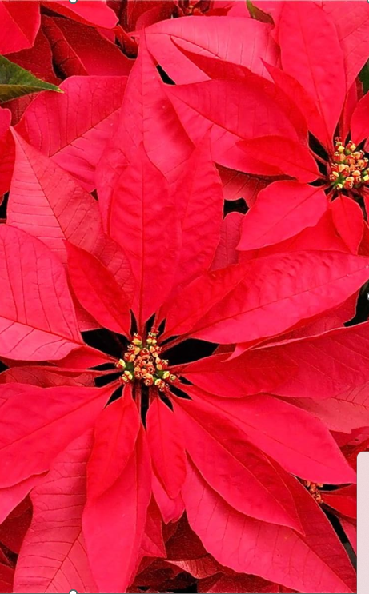
Christmas
Potted plants while still 1st in dollar sales suffered large dollar & volume declines compared to 2021
 | Dollar Sales (MM) | % Chg vs YA | Unit Sales (MM) | % Chg vs YA | Avg. wkly $MM ACV | Chg vs YA | Price/ Unit | % Chg vs YA | % Dollar, Any Merch | Chg vs YA
Potted Plants | 113.7 | -8.8% | 12.5 | -11.0% | $21.1 | -$4.3 | $9.07 | +2.5% | 26.4 | +5.2
Rose | 83.9 | +5.8% | 6.6 | +0.2% | $16.0 | -$0.6 | $12.79 | +5.5% | 12.5 | +2.3
Bouquet | 83.6 | +2.0% | 6.6 | -0.6% | $16.8 | -$1.2 | $12.70 | +2.7% | 13.8 | +2.1
Arrangement | 65.4 | -1.9% | 2.3 | -12.1% | $13.4 | -$1.8 | $28.97 | +11.7% | 27.1 | +0.3
Consumer Bunch | 53.3 | +2.8% | 8.5 | -5.8% | $11.1 | -$0.6 | $6.26 | +9.1% | 12.6 | -0.3
Holiday | 16.3 | -1.6% | 1.1 | -2.3% | $5.8 | -$0.4 | $15.40 | +0.7% | 42.0 | +4.3
Outdoor Plant | 6.3 | +28.3% | 0.7 | +9.1% | $3.6 | -$1.6 | $8.67 | +17.6% | 21.8 | +4.4
Bulb | 4.5 | +9.0% | 0.8 | +6.9% | $1.9 | -$0.1 | $5.31 | +2.0% | 36.3 | +14.8
Seed | 3.5 | -34.8% | 0.3 | -54.0% | $2.0 | -$1.1 | $13.45 | +41.7% | 10.7 | -5.8
Lean on holiday decor to maintain and grow sales in potted plants at Christmas.

Slide 16
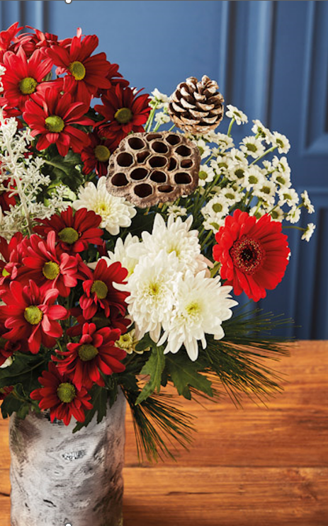
Christmas
Arrangements declined in dollar sales as consumers pulled back in spending
 | Chg vs YA ($MM) | Dol Sales ($MM) | % Chg vs YA | TPOD | Chg vs YA | Wt. Base Price/ Unit | % Chg vs YA | Promo Price | Chg vs YA
Holiday | -$0.3 | $16.3 | -1.6% | 266.5 | -16.4 | $19.21 | -4.4% | $12.85 | +0.85
Arrangement | -$1.2 | $65.4 | -1.9% | 598.6 | -39.6 | $31.82 | +10.8% | $27.89 | +2.72
Seed | -$1.9 | $3.5 | -34.8% | 284.4 | -62.7 | $14.08 | +37.7% | $9.87 | +2.85
Potted Plant | -$10.9 | $113.7 | -8.8% | 2,907.3 | -384.4 | $10.33 | +5.7% | $7.61 | +0.27
Offering arrangements at various price points allows consumers to find room in their budget.
1
2
3
4

Slide 17
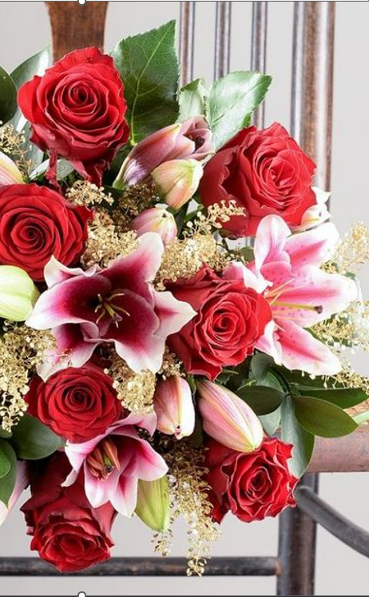
Christmas
Rose increased in dollar and volume sales
 | Chg vs YA ($MM) | Dol Sales ($MM) | % Chg vs YA | TPOD | Chg vs YA | Wt. Base Price/ Unit | % Chg vs YA | Promo Price | Chg vs YA
Rose | +$4.6 | $83.9 | +5.8% | 1,015.2 | +7.5 | $13.31 | +6.8% | $11.31 | +0.40
Bouquet | +$1.6 | $83.6 | +2.0% | 1,207.7 | +18.5 | $13.31 | +3.6% | $10.44 | +0.42
Consumer Bunch | +$1.5 | $53.3 | +2.8% | 1,354.4 | +141.4 | $6.51 | +8.5% | $5.24 | +0.27
Outdoor Plant | +$1.4 | $6.3 | +28.3% | 394.4 | +36.0 | $9.98 | +22.4% | $9.69 | +3.15
Bulb | +$0.4 | $4.5 | +9.0% | 372.9 | -3.3 | $6.69 | +11.9% | $4.84 | +0.28
As roses continue in popularity, highlight this product in unique bouquets and arrangements to advance those sales.
1
2
3
4
5

Slide 18
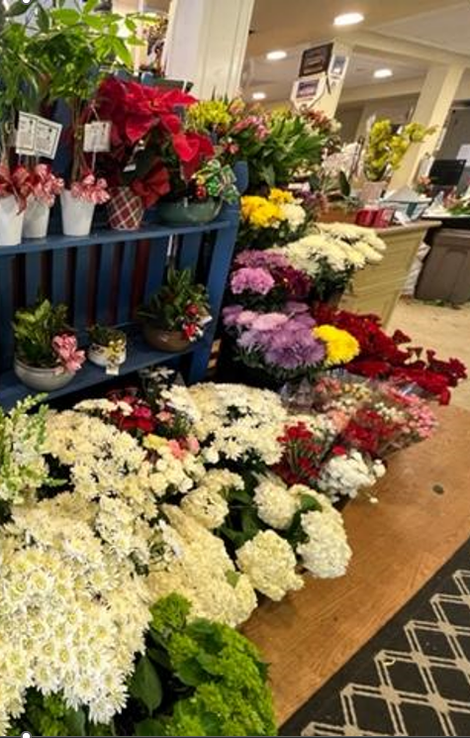
Christmas
Dollar sales increased the week prior to Christmas over 2021 and 2020 after lagging for several weeks
Review product assortment to keep continue growing dollar sales.

Slide 19
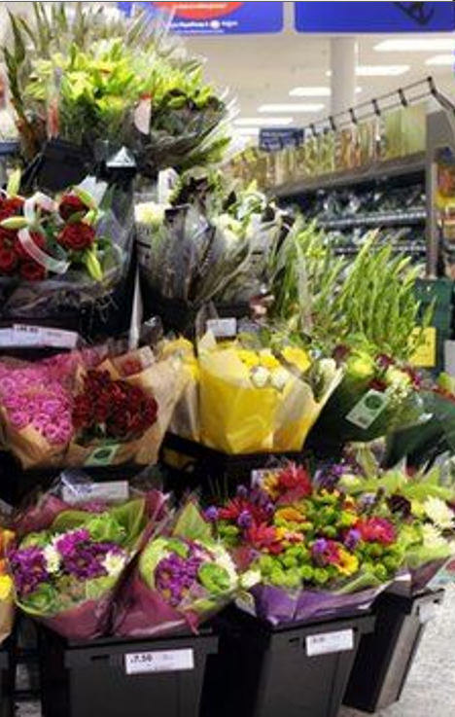
Christmas
Unit sales dropped to 2020 levels
Review product assortment and discounts to grow unit sales.

Slide 20
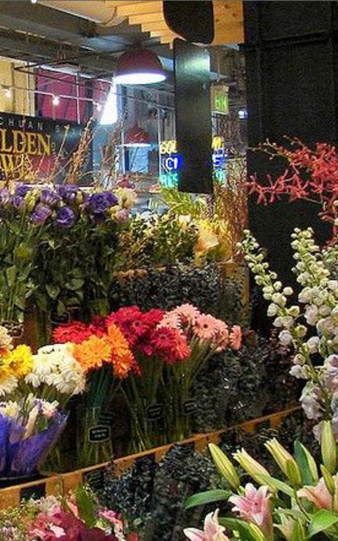
Christmas
Floral kept its price increase over the holiday
Continue to promote the value of floral to maintain and increase price.

Slide 21
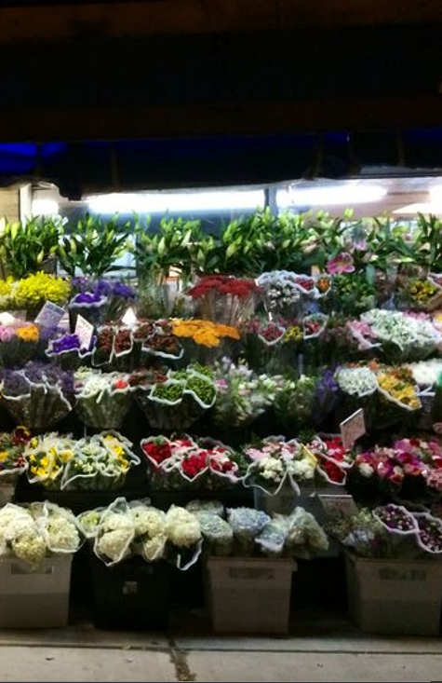
Christmas
Floral average dollar & unit sales were lower in 2022 than 2021
Review product assortment, pricing strategies, and promotional messaging to increase dollar and unit sales for Christmas

Slide 22


Research Methodology
Background
Floral Department Overview
IRI Reviews DB
IRI_INTEGRATED_FRESH_MARKET_ADVANTAGE
Geography
Total US - Multi Outlet
Time Period Custom
“CY 2022 (52 Weeks Ending 01-01-2023)”,
“Thanksgiving Season (4 Weeks Ending 11-27-2022)” and
“Christmas Season (4 Weeks Ending 01-01-2023)”
Key Aisle
Floral Aisles and
Floral Categories (Potted Plant, Rose, Bouquet, Outdoor Plants, Consumer Bunch, Arrangement, Seeds, Bulb, Holiday)

Slide 23
Thank You!

